Slide 1
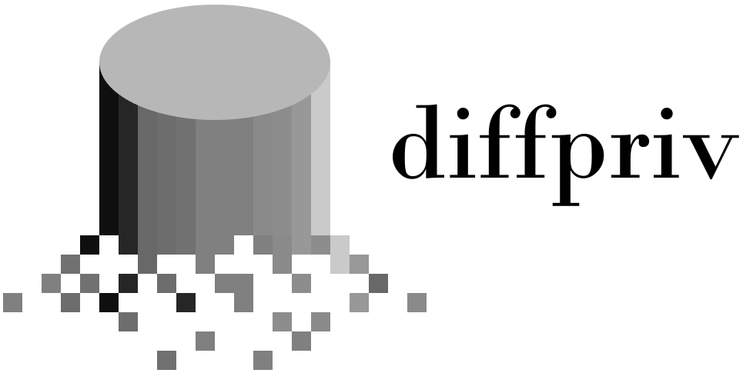

Provably-private learning in R

Slide 2
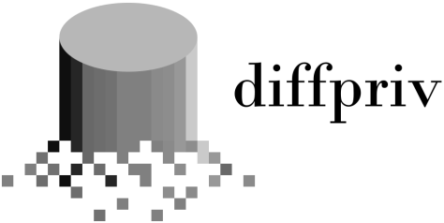
Apple iOS10.x
U.S Census Bureau: OnTheMap
Differential Privacy Deployments
Google Chrome: RAPPOR
Transport for NSW: Opal Data
Uber: Elastic Sensitivity

Slide 3



Differential Privacy
Guarantee Release aggregate info on dataset, protect privacy of individuals.
Unreasonable expertise
Must calculate “sensitivity” by hand per new deployment.
diffpriv eliminates the maths with advanced sampling theory

Slide 4
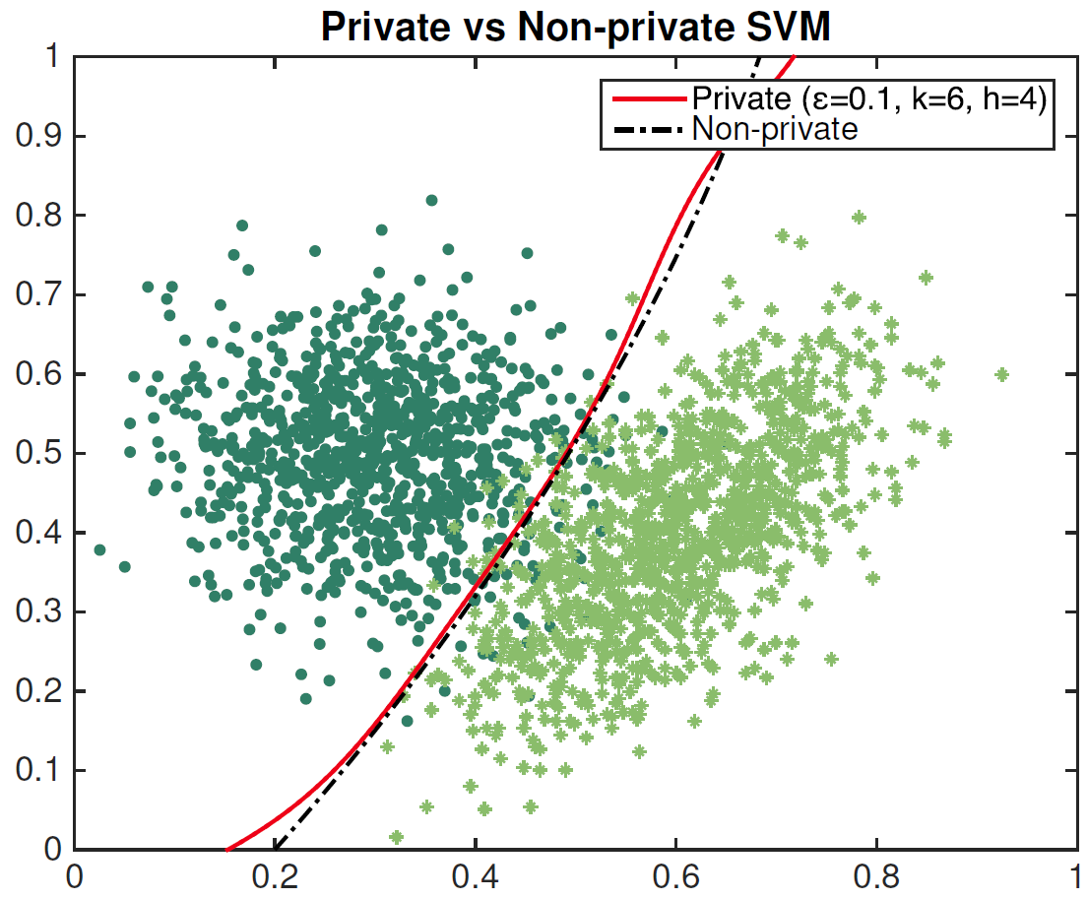
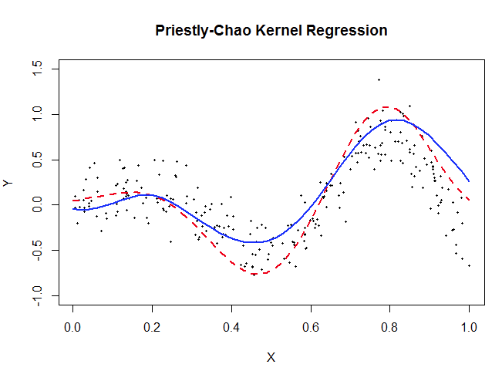
Examples
M <- DPMechBernstein(target=pck_regression, latticeK=50)
M <- sensitivitySampler(M, oracle=P, n=n, gamma=0.2, m=500)
releaseResponse(M, DPParamsEps(epsilon=1), X=traindata)

